Slide 1
Player
Attack an enemy character
Pick up treasure from enemy or the ground
Can check if about to hit a wall.
Dies if health goes to 0
Wins if player survives through round 3
Number of responsibilities: 6
Maze
Enemy
Treasure
Game
Number of Collaborators: 4

Slide 2
Enemy
Attacks player
Drops treasure (certain probability)
Dies if health goes to zero
Number of Responsibilities: 3
Player
Maze
Game
Treasure
Number of Collaborators: 4

Slide 3
Maze
Generated by the Maze Generator
Keeps track of what level player is on.
Holds locations of everything.
Checks if the player is on the winning spot.
Number of Responsibilities: 3
Maze Generator
Tile
Game
Number of Collaborators: 5

Slide 4
Maze Generator
Creates the mazes
Checks if the player can get to the end of the maze (Flood Fill Method).
Outputs each maze to a .txt file.
Number of Responsibilities: 3
Maze
Number of Collaborators: 1

Slide 5
Treasure
Increases the stats of the player based on the type.
Can be dropped by enemy or found on the floor of the maze
Number of Responsibilities: 2
Maze
Player
Enemy
Game
Maze Generator
Number of Collaborators: 5

Slide 6
Weapon
Compares with the weapon of the player to see if the weapon is better than the player’s
Increases stats of the player.
Creates Unique Weapon
Number of Responsibilities: 2
Player
Tile
Number of Collaborators: 1

Slide 7
Game
Runs the processes of the game
Manages the player, enemies, mazes, and treasure
Checks for winning and losing conditions using objects within the class.
Number of Responsibilities: 3
Maze
Maze Generator
Player
Enemy
Treasure
Number of Collaborators: 5

Slide 8
Tile
Holds player, weapon, treasure, or enemies.
Allows player to exit to the next level.
Number of Responsibilities: 2
Maze
Maze Generator
Player
Weapon
Treasure
Enemy
Number of Collaborators: 6

Slide 9
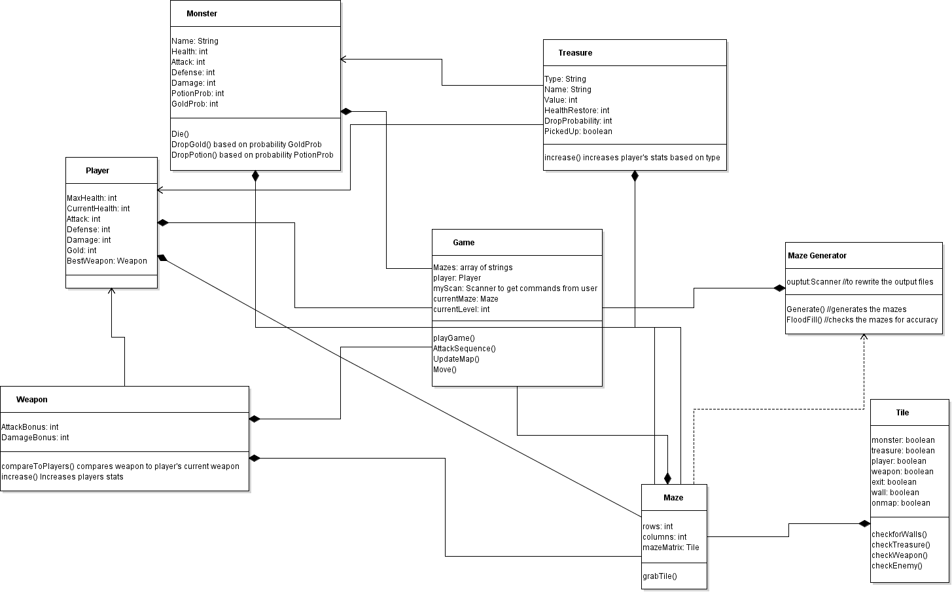

Slide 10
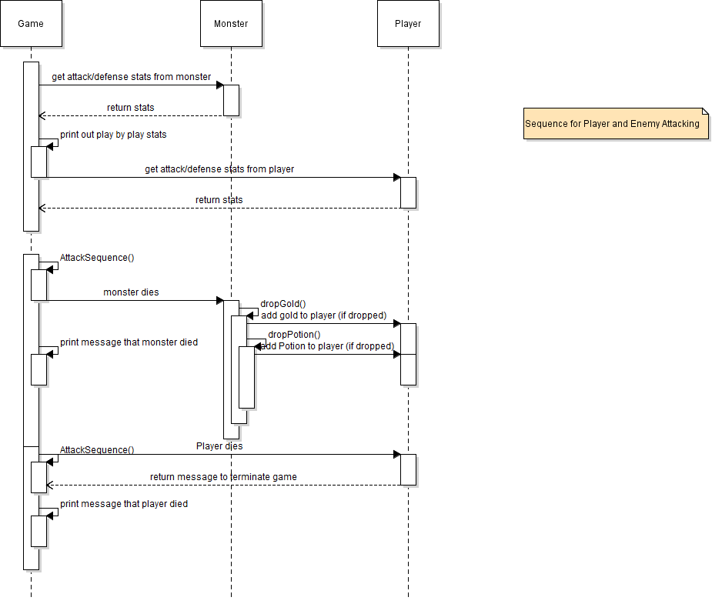

Slide 11
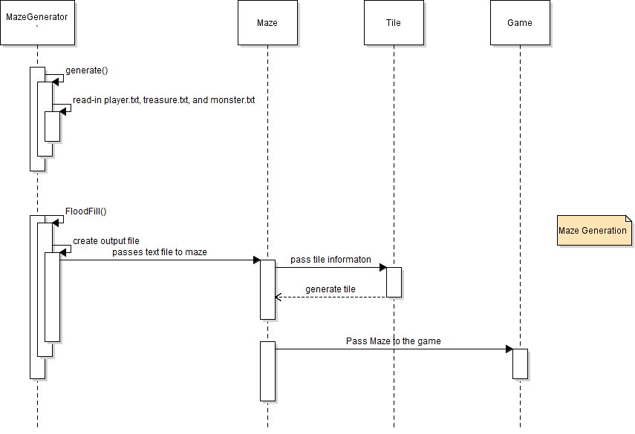

Slide 12
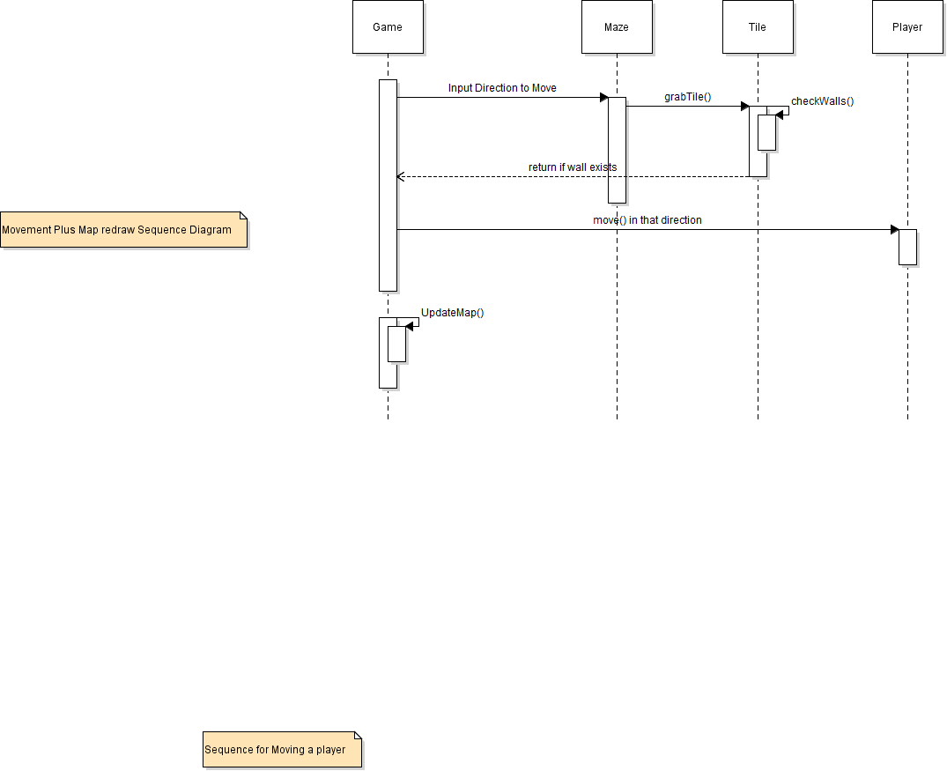

Slide 13
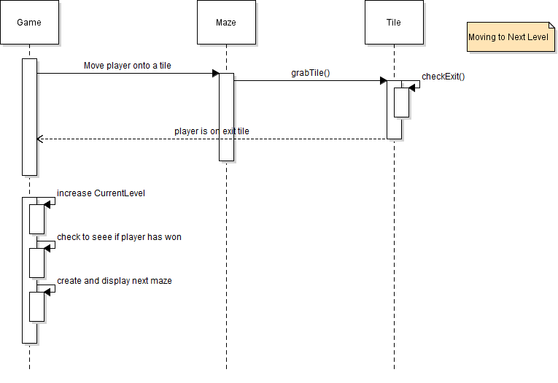

Slide 14
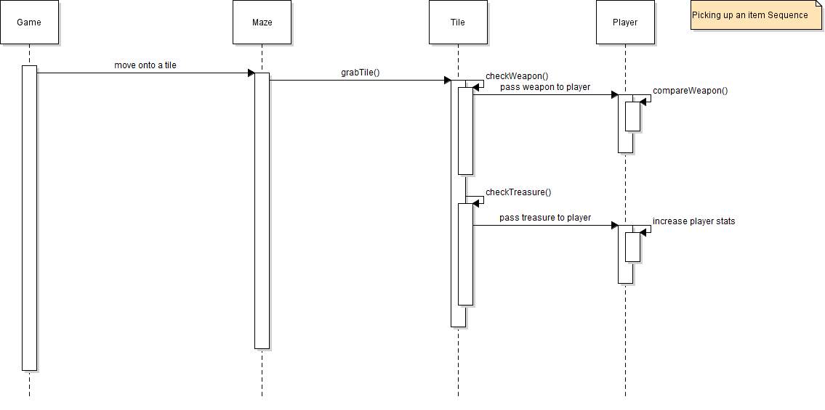

Slide 15
